Slide 1

Automated Build and Test
#sqlinthecity
Steve Jones
Editor, SQLServerCentral
Red Gate Software

Slide 2

Goals
#sqlinthecity
Why continuous integration?
Testing is important
It’s easy – setup and running in an hour
Do feel free to ask questions!

Slide 3
Continuous Integration
What is it?

Slide 4
#sqlcity
What is continuous integration?
“Continuous Integration is a practice designed to ensure that your software is always working, and that you get comprehensive feedback in a few minutes as to whether any given change to your system has broken it.”
Jez Humble, ThoughtWorks, author of “Continuous Delivery”

Slide 5
database
^
#sqlcity
What is continuous integration?
“Database Continuous Integration is a practice designed to ensure that your database software is always working, and that you get comprehensive feedback in a few minutes as to whether any given change to your system has broken it.”
Jez Humble, ThoughtWorks, author of “Continuous Delivery”

Slide 6
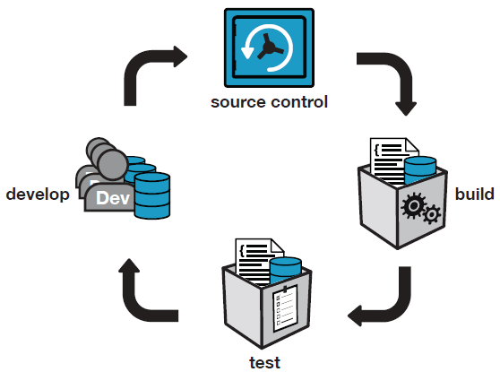
Database Continuous Integration
Notes:
CI server is set up by one person and the whole team of developers benefits.

Slide 7
What is build?
For application code = compile
For database code = database creation script
But only for a new installation!
Upgrade scripts required for existing installations
Need to preserve the state of the data
Notes:
The testing of deployment scripts is customarily left to the end.
=> Issues with upgrades only found at the end of a project.

Slide 8
Tools we need
#sqlinthecity
CI tools (we use TeamCity by JetBrains)
Database Integration (we use SQL Automation Pack with the Red Gate TeamCity plugin)
Version Control (we use Subversion with SQL Source Control)
Testing framework (we tSQLt and SQL Test)
Test data (we use SQL Data Generator)
Documentation (we use SQL Doc)
Notes:
Show of hands for SQL Developer Bundle.
TeamCity is used at Red Gate but *any* build server can be used, eg:
Jenkins, Hudson, TFS Build, CruiseControl, Bamboo, etc.
There is a sqlci.exe command line, and NAnt and MSBuild template wrappers available.

Slide 9
Demo
Continuous Integration Setup

Slide 10
Keeping a database up to date
With?
Schema
Static data
Why?
A corresponding database for the application
Maintaining a test database with the latest changes

Slide 11
Testing
Why it’s important

Slide 12
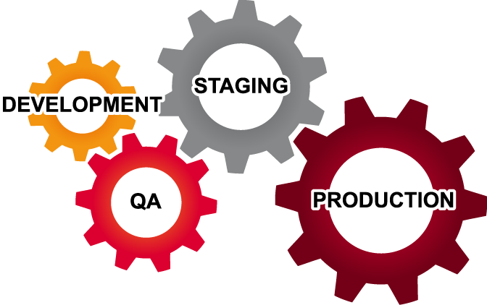
Where does testing happen?
Testing isn’t just done in QA
Be aware of the cost of fixing a bug
Notes:
There are pre-dev phases where testing could also happen –requirements analysis, architecture, functional specification.

Slide 13
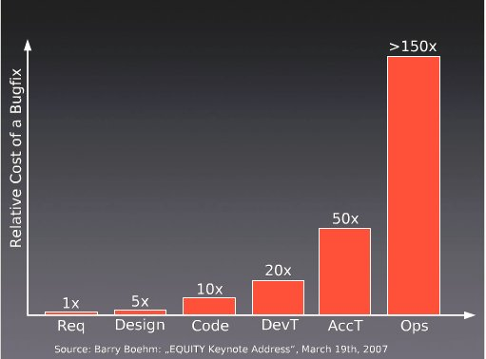
Cost of Bugs

Slide 14
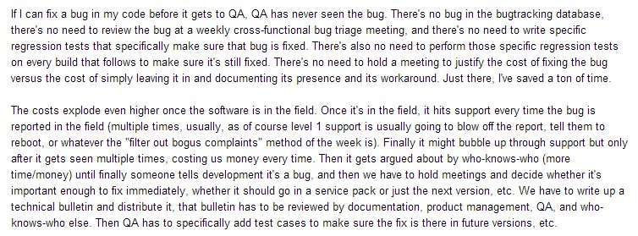
Does the cost of bugs rise?

Slide 15
Does the cost of bugs rise?

Slide 16
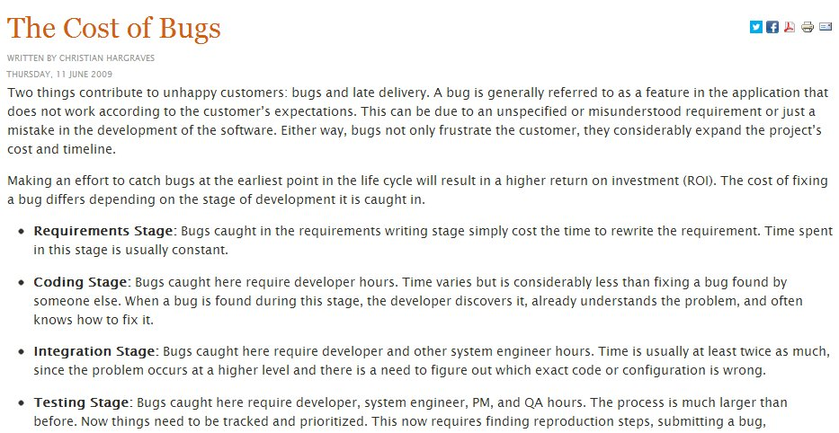

Slide 18
Testing in Development
Low(er) costs
No inter-team interactions
Changes are discrete
However
Increased frequency of changes (higher cost)
Notes:
Testing in development is preferred as the costs as low, or relatively low compared to finding bugs and issues later.
The lower costs come because testing is done in one team, or with one person. The changes are also discrete in that there aren’t a large bundle of changes being put together over time for deployment. Small bits of change are occurring.
However there are more changes, which means more costs to the tests and running a suite of tests.
The key here is automation.

Slide 19
What is test?
For .NET code, NUnit.
Runs on a developer’s machine and build server
What about the database?
tSQLt is an open source framework for testing SQL Server databases
SQL Test provides SSMS integration
Notes:
Although CI catches issues that arise when developers have failed run tests locally, also solving a different problem:
- Two incompatible changes committed by different developers
- “Works on my machine” in development.
Issues that only arise in more realistic integration environments.

Slide 20
tSQLt and SQL Test
tSQLt is (the best) free open-source unit testing framework for SQL Server
tSQLt.org
Support via GoogleGroups
Part of the SQL Developer Bundle, SQL Test provides a GUI for tSQLt in SSMS

Slide 21
Demo
Testing the build

Slide 22
Why generate test data?
Dev environments are often not realistic
Getting production data not always possible
Random data can result in surprises
Volume testing can find performance issues

Slide 23
Demo
Testing with larger data sizes

Slide 24
Two bugs found by SQL Data Generator
NULL Dates
App code assumed [Date] wouldn’t be NULL
SQL Data Generator didn’t
Fix was to change [Date] to be NOT NULL
Performance of v_Articles
Test passed on dev box
Failed in more “realistic” CI environment

Slide 25
Generate SQL Documentation
An up-to-date resource
For Developers
DBAs
Business Analysts

Slide 26
Deployments Scripts
Creation scripts
For new installations
Upgrade Scripts
For existing installations
Requires Deployment Manager
Notes:
Creates database packages, used for reliable and repeatable deployments

Slide 27
Summary
#sqlinthecity
Why and how to put automated database build and test in place
Overview of the tools required
Can be set up in less than an hour!
Notes:
We’ve covered:
How to create a new build in TeamCity from scratch
(including VCS root, build trigger)
How to use Red Gate’s plugin for SQL CI.
Keeping a database up to date
Testing a database with tSQLt
Generating data
Publishing documentation
Building the deployments scripts (creation and upgrade)
Building a database package that can be consumed by Deployment Manager.

Slide 28
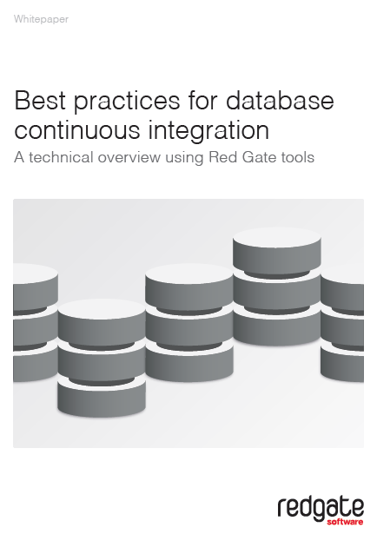
#sqlinthecity
Latest version at : www.red-gate.com/CI
Questions?

Slide 29
References
http://assets.red-gate.com/products/sql-development/assets/continuous-integration-using-red-gate-tools.pdf
http://www.jetbrains.com/teamcity/
http://developers.slashdot.org/story/03/10/21/0141215/software-defects---do-late-bugs-really-cost-more
http://tech.lds.org/index.php?option=com_content&view=article&id=238:the-cost-of-bugs&catid=1:miscellanous

